Slide 1

TECHNICAL SEO
AUDIT PRESENTATION
www.
.com
Project Details
University | Maltepe University
Course | SE 465 01 Case Studies in Software Engineering II
Teacher | Cem Cantekin
Project Participants
Full Name | Student Number
Alp Salcıoğlu | 220706016
Muharrem Şimşek | 210706001
Ünal Kamçılı | 200706315

Slide 2
Table Of Contents
Introduction
Website Overview
Recommendations
SEO Performance Summary & Key Findings
Indexing & Crawlability
On-Page SEO Factors
Keyword Consistency
Top Keyword Rankings
Image Alt Attribute
Internal & External Linking
Backlink Summary
Domain
Technical SEO Factors
Performance & User Experience (UX) Optimization
Google’s Core Web Vitals
Server & Security
Local SEO & Business Listings
Technology Results
Social Media & Analytics
Key Findings & Recommendations
Conclusion
End ( Report Link)

Slide 3
Introduction
Purpose of the SEO Audit:
Evaluate the technical SEO performance of www.sosyopix.com
Identify issues affecting indexing, crawlability, on-page SEO, and user experience
Provide actionable recommendations for improving site rankings and performance
Scope of the Audit:
Indexing & Crawlability
On-Page SEO Optimization
Linking & Backlinks Profile
Technical SEO Analysis
Performance & UX Optimization
Security & HTTPS Implementation
Local SEO & Social Media Presence

Slide 4
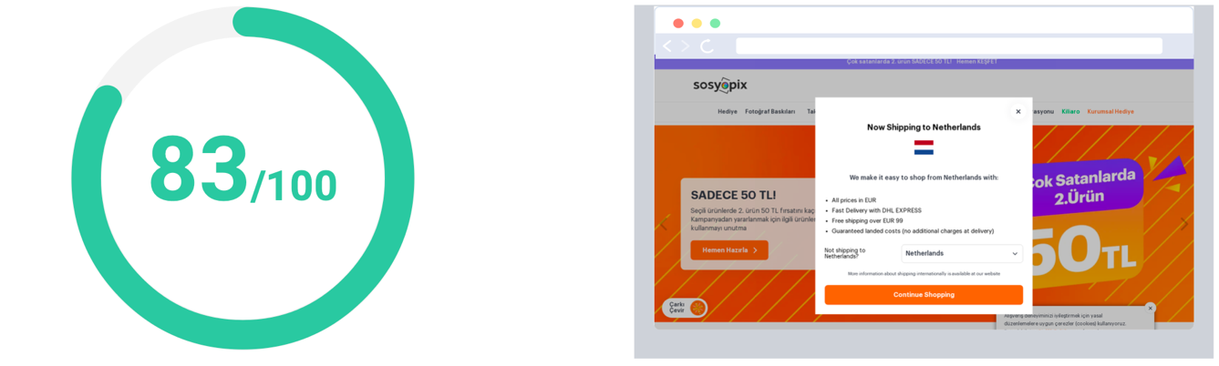
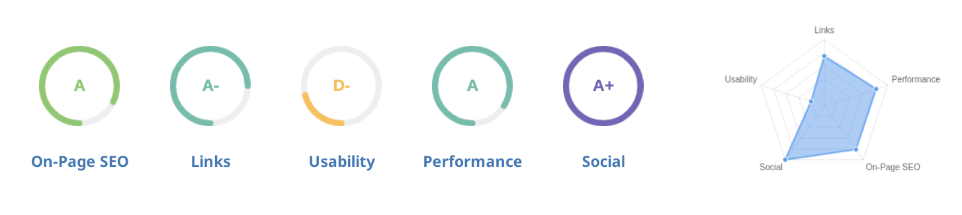
Website Overview
Sosyopix is an e-commerce platform specializing in customized gifts and photo printing services.
The website is well-optimized but still has some technical SEO issues that need improvement.
Areas of strong performance:
Good title and meta descriptions
Valid XML Sitemap and Robots.txt
Secure HTTPS implementation
Areas that need improvement:
Core Web Vitals and Page Speed
Keyword consistency and ALT attributes
Structured data and schema markup
Good result! The web page is well optimized, but there's always a room for improvement.

Slide 5
Recommendations
Optimize for Core Web Vitals | Usability | Medium Priority
Shorten meta description(to between 120 and 160 characters) | On-Page SEO | Medium Priority
Use the main keywords across the important HTML tags | On-Page SEO | Low Priority
Optimize the page for Mobile PageSpeed Insights | Usability | Low Priority
Optimize the page for Desktop PageSpeed Insights | Usability | Low Priority
Add Alt attributes to all images | On-Page SEO | Low Priority
Remove inline styles | Performance | Low Priority
Resolve JavaScript errors | Performance | Low Priority
Remove iFrames | Usability | Low Priority
Add business address and phone number | Other | Low Priority
Add Local Business Schema | Other | Low Priority

Slide 6
SEO Performance Summary & Key Findings
Good Optimization in several areas but needs improvements.
Main Issues Identified:
Low Core Web Vitals scores (LCP, CLS issues)
Slow mobile page speed (44/100)
Missing structured data (Schema Markup)
Some broken links detected
Low keyword distribution in HTML elements
Recommendations:
Improve Core Web Vitals and lazy loading
Optimize keyword usage in headers and meta descriptions
Fix broken links and improve backlink quality

Slide 7
Indexing & Crawlability
Robots.txt File:
Present and properly configured
https://www.sosyopix.com/robots.txt
XML Sitemap:
Valid and correctly structured
Multiple sitemaps exist for different languages and images
https://www.sosyopix.com/en/sitemap.xml
https://www.sosyopix.com/sitemap.xml
https://www.sosyopix.com/en/image_sitemap.xml
https://www.sosyopix.com/image_sitemap.xml
Canonical Tags:
Used correctly to prevent duplicate content issues
No major indexing issues detected
<link rel=”canonical”
href=”https://www.sosyopix.com/” />

Slide 8
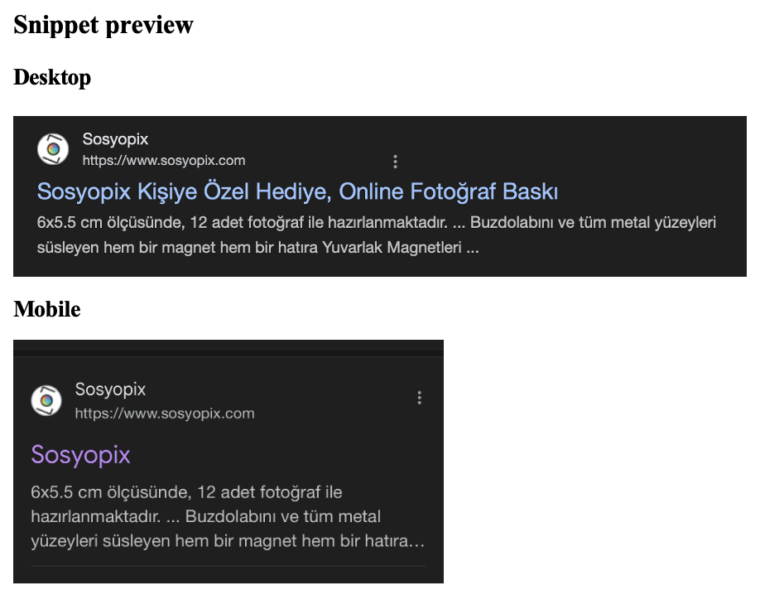
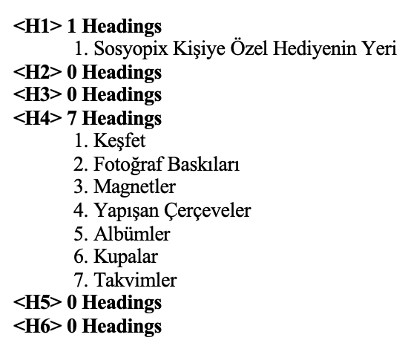
On-Page SEO Factors
Title:
“Sosyopix Kişiye Özel Hediye, Online Fotoğraf Baskı” (52 characters, 416 pixels)
Meta Description:
Too long (162 characters, should be between 120-160 characters)
Header Structure (H1-H6 Usage):
One H1 tag detected → Needs more structured headings
No H2 or H3 tags
7 H4 tags for navigation items (not ideal for SEO)

Slide 9
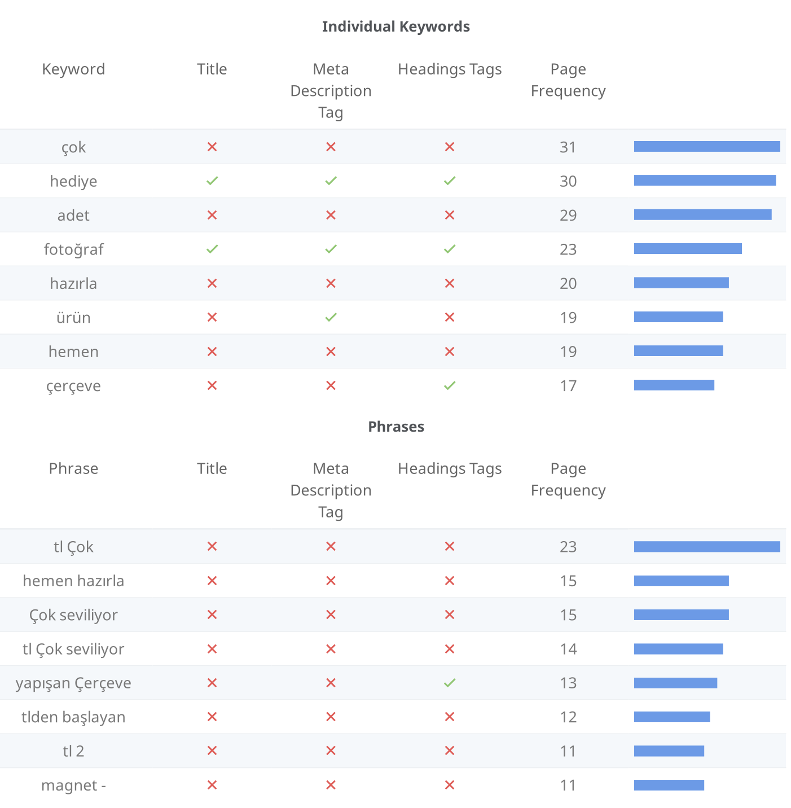
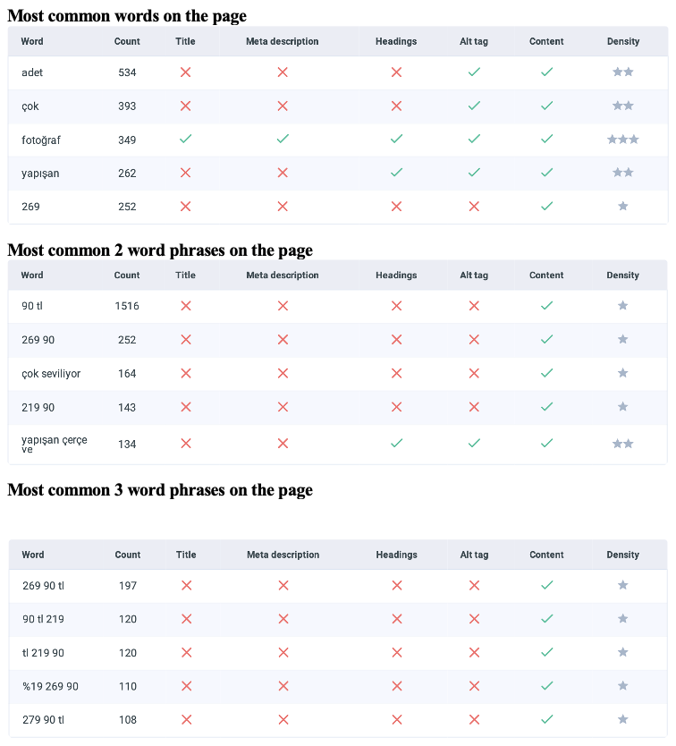
Keyword Consistency
Most Common Words

Slide 10
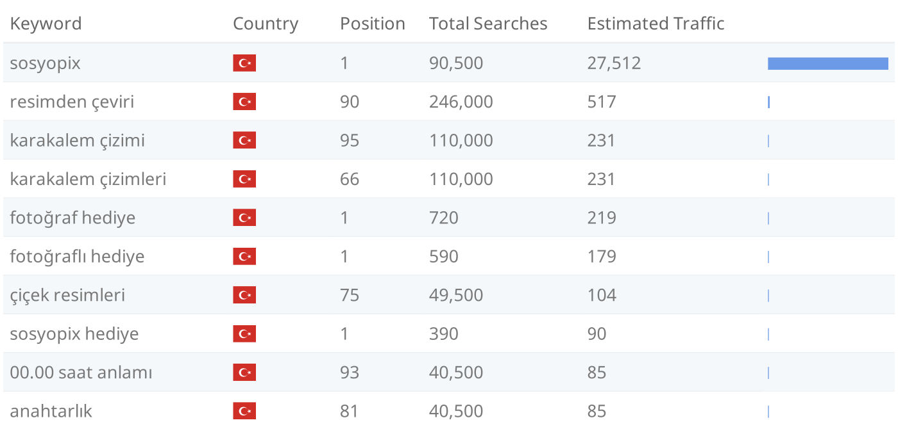
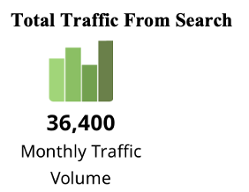
Top Keyword Rankings
This shows the top 10 Keyword Rankings in the specic location. The list is ordered by the keywords that drive the most traffic to the page.

Slide 11
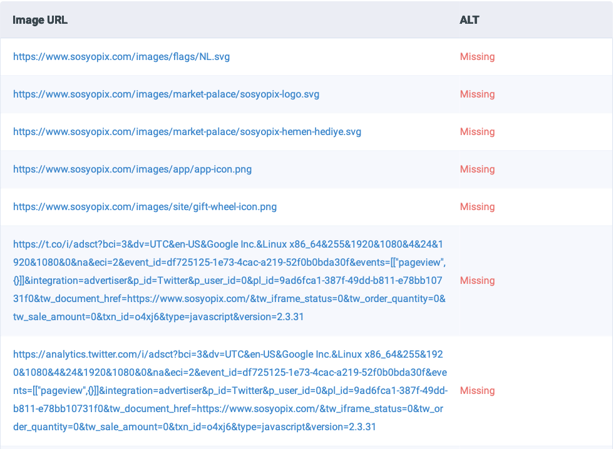
Image Alt Attribute
We found 173 images on the page.
7 alt attributes are empty or missing.

Slide 12
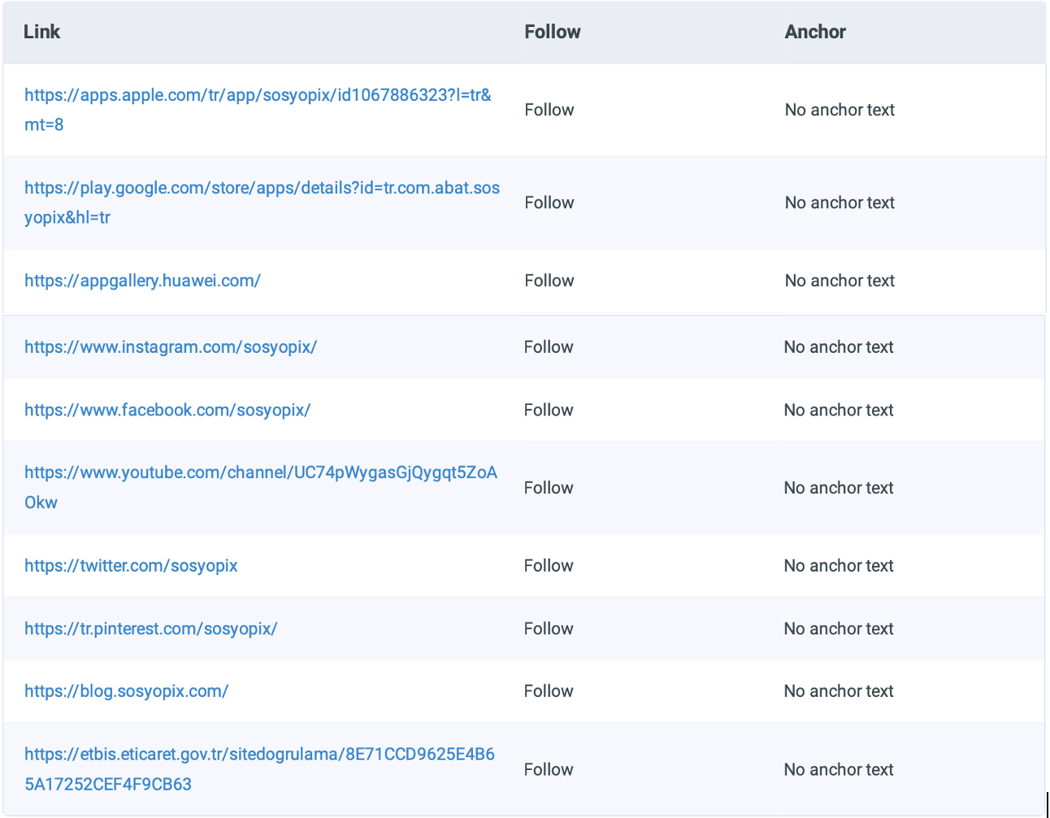
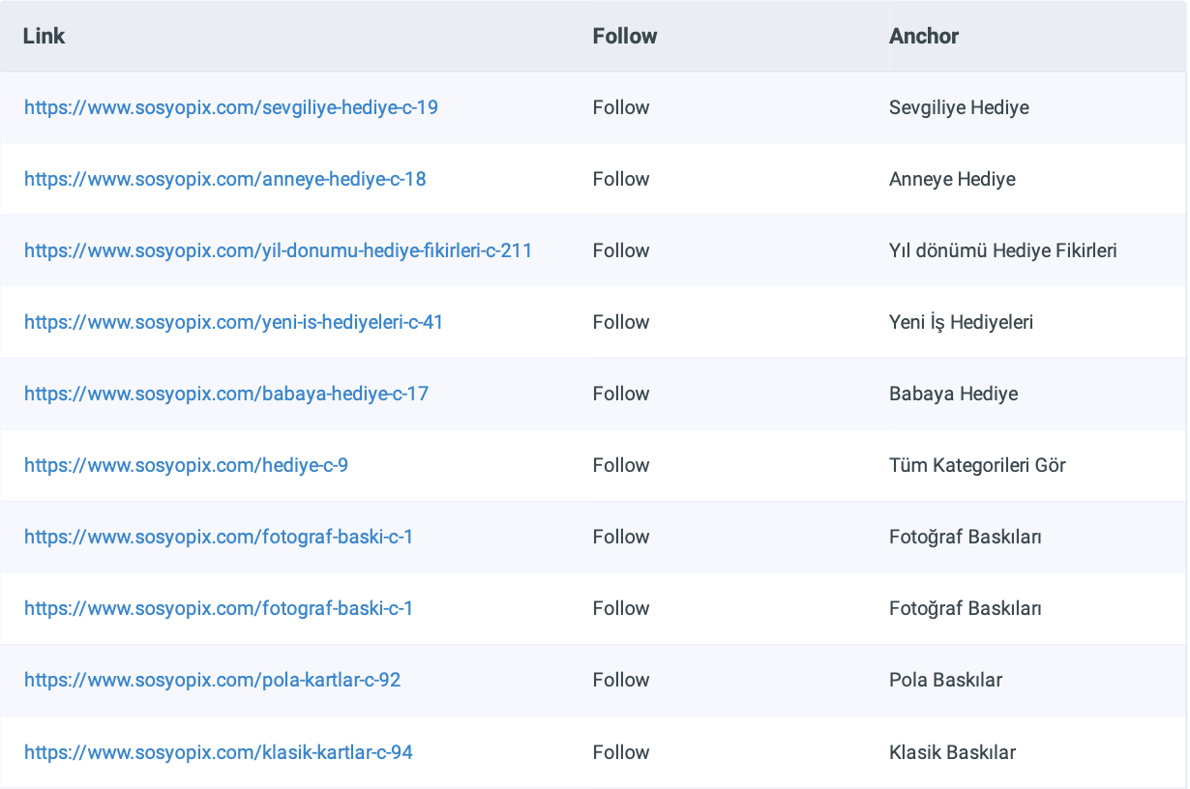
Some of the External Links
Internal & External Linking
We found 253 links on the page
Internal Links:
Well-structured but could be improved for SEO
External Links & Backlinks:
Strong backlink profile but requires continuous monitoring
Broken Links:
Two broken links detected (high priority)
https://t.co/i/adsct?bci=3&dv=UTC&en-US&Google Inc.&Linux x86_64&255&1920&1080&4&24&1920&1080&0&…
https://www.googletagmanager.com/
Some of the Internal Links

Slide 13
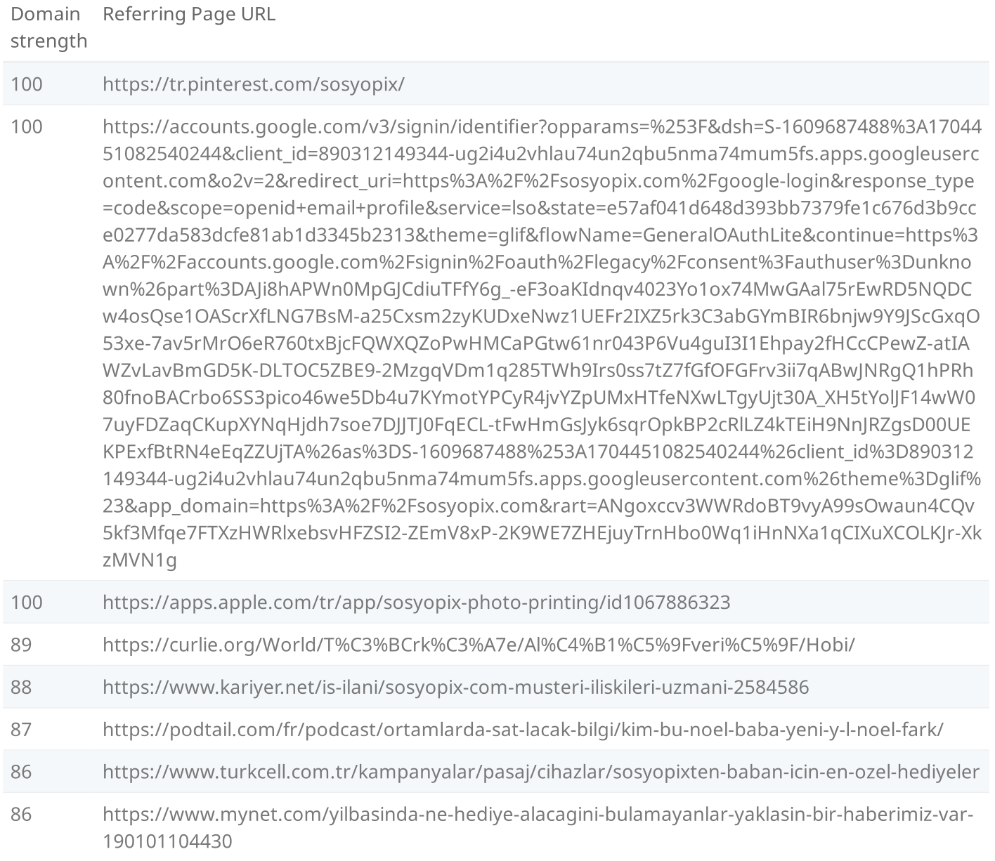
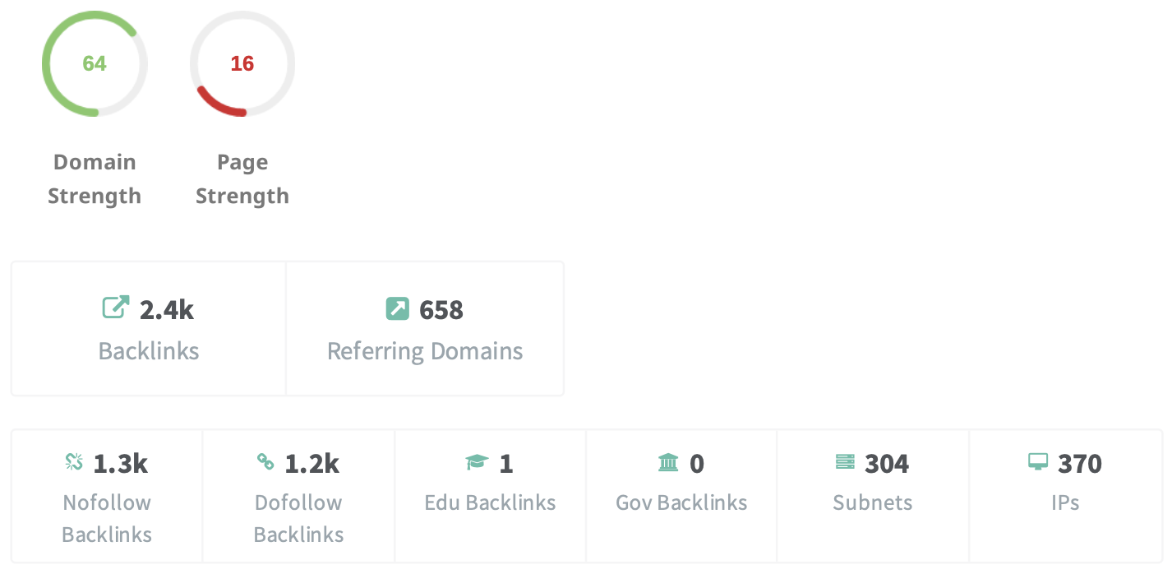
Backlink Summary
Top Backlinks
This page have a strong level of backlink activity to this page.
These are the highest value external pages we have found linking to the site.

Slide 14
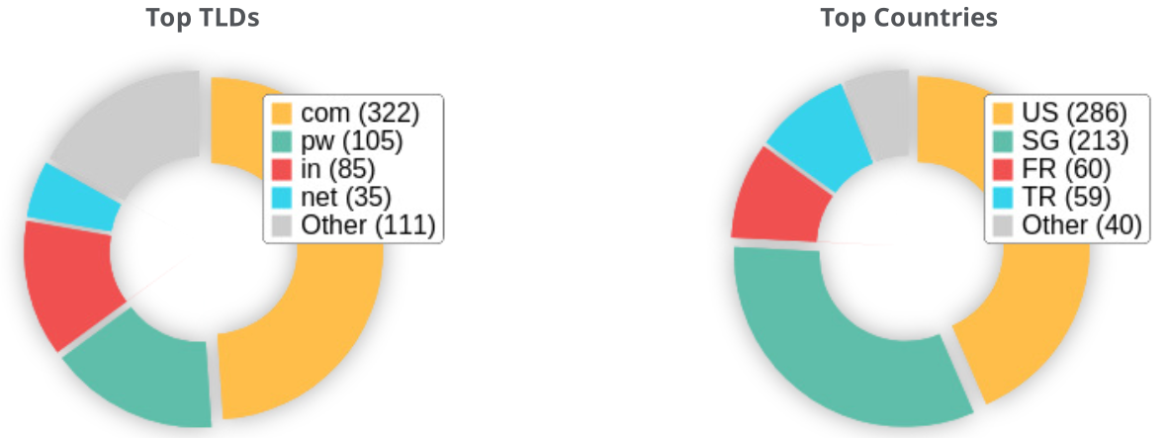
Domain
Domain age: The domain age is 13 years 3 days
Created: Apr 19, 2014
Expires: Apr 19, 2027
These are the Top Geographies we have found linking to the site.

Slide 15
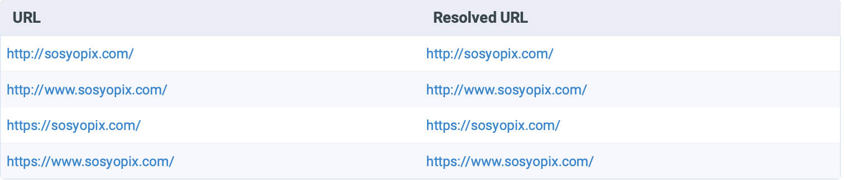
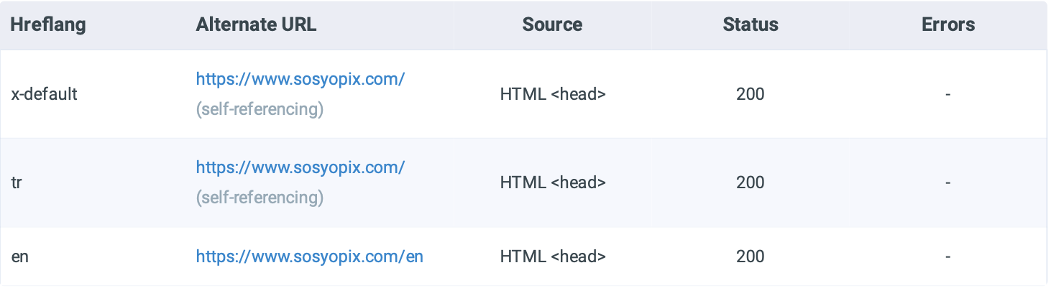
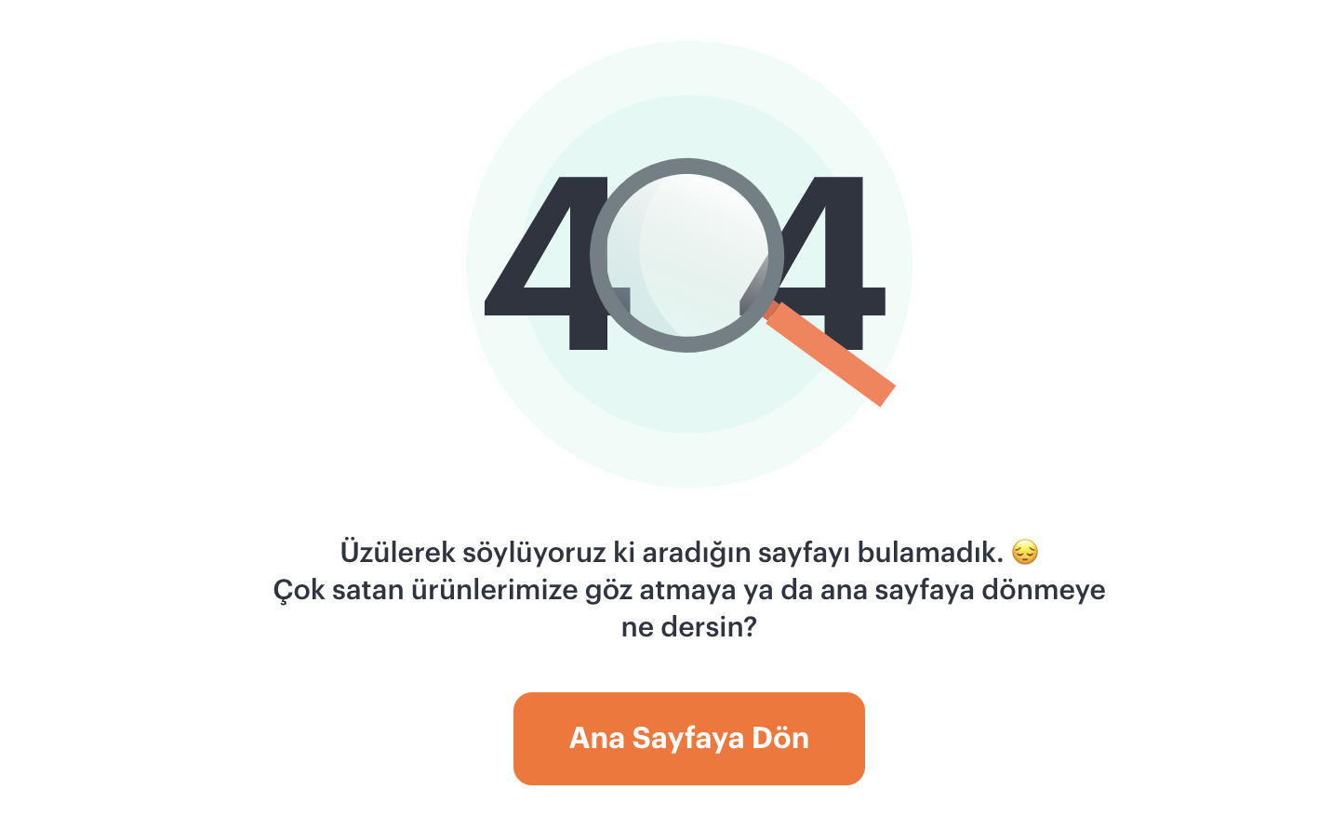
All versions of the web page point to one url.
Technical SEO Factors
URL Structure & Redirects:
All versions correctly resolve to one URL
404 Errors:
Custom 404 page exists but should include navigation links
Structured Data & Schema Markup:
Missing schema markup for Local Business, Products, and Breadcrumbs
Hreflang Tags:
Correctly implemented for different languages
3 hreflang tags was found
404 page of the website

Slide 16
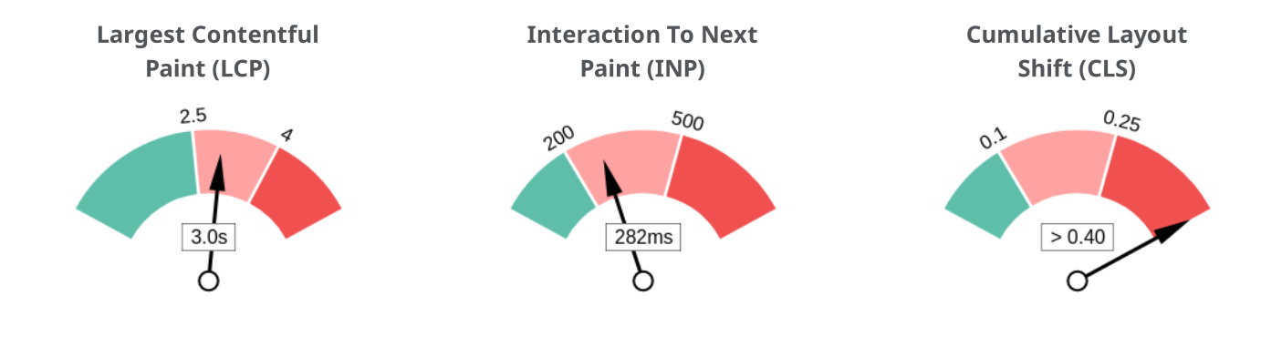
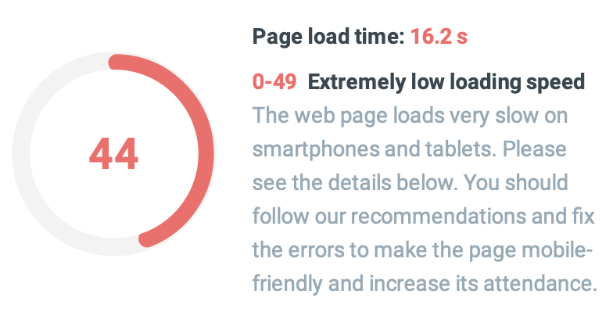
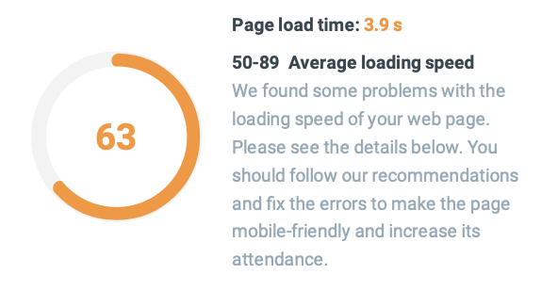
Performance & User Experience
Optimization
Core Web Vitals
Mobile
Page Speed Scores:
Mobile: 44/100 (Poor)
Desktop: 63/100 (Moderate)
Core Web Vitals:
LCP and CLS issues affecting UX
Render blocking resources detected
Lazy loading and image compression needed
Mobile Usability:
Tap elements properly spaced
Viewport correctly configured
Desktop

Slide 17
Google’s Core Web Vitals
Metric | Mobile Score | Desktop Score | Optimization Needed?
Overall PageSpeed Score | 44/100 | 63/100 | Mobile Needs Improvement
First Contentful Paint | 3.2s | 1.8s | Reduce Render Blocking
Largest Contentful Paint | 3.8s | 2.5s | Optimize Images & Lazy Load
Cumulative Layout Shift | 0.22 | 0.12 | Mobile Needs Fixes
Time to Interactive | 4.5s | 2.3s | Minimize JavaScript
The page has failed Google's Core Web Vitals assessment. Core Web Vitals are UI metrics created by Google that measure page experience and are becoming increasingly important as a ranking factor.

Slide 18
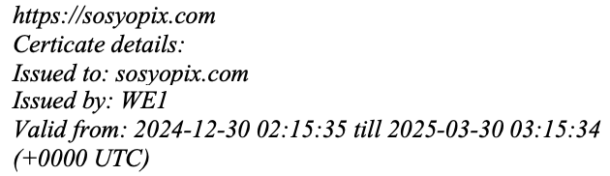

Server & Security
SSL technology ensures an encrypted, key-based connection that eliminates the risk of unauthorized access to personal data and allows for the dependable user experience.
SSL & HTTPS Implementation:
Secure SSL certificate correctly configured
Server Performance:
Fast server response time (0.0 sec)
Using Cloudflare for security & performance optimization
Mixed Content Issues:
No major issues detected
IP Address
Page Status

Slide 19
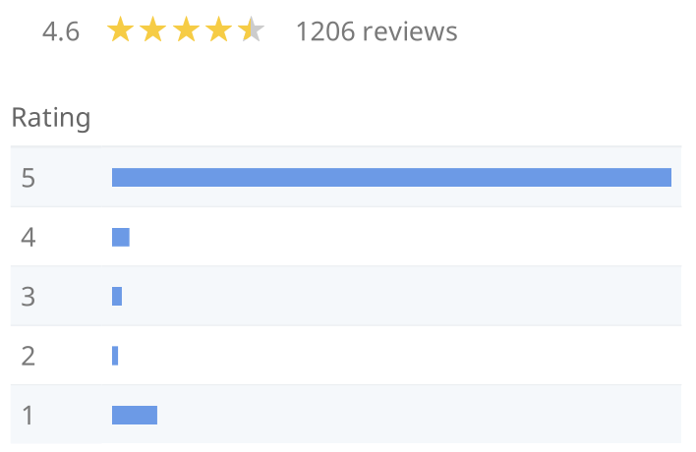
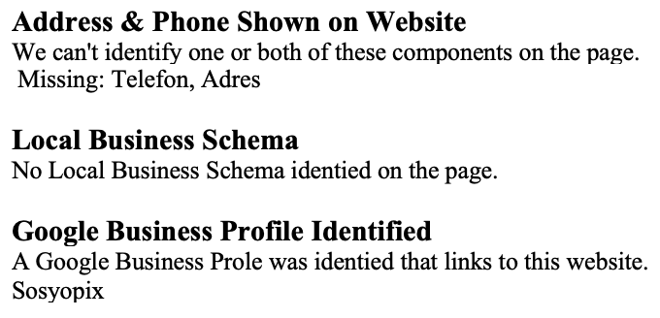
Google Reviews
Local SEO & Business Listings
Google Business Profile Detected
Missing Local Business Schema
Address & Phone Number should be more visible on the website
Google Business Profile Completeness
The important business details are present on the Google Business Prole.
Address: Esentepe, Muallim Seday Bey Sok No:8, 34870 Kartal/ stanbul, Türkiye
Phone: +90 216 380 33 00
Site: https://www.sosyopix.com/

Slide 20
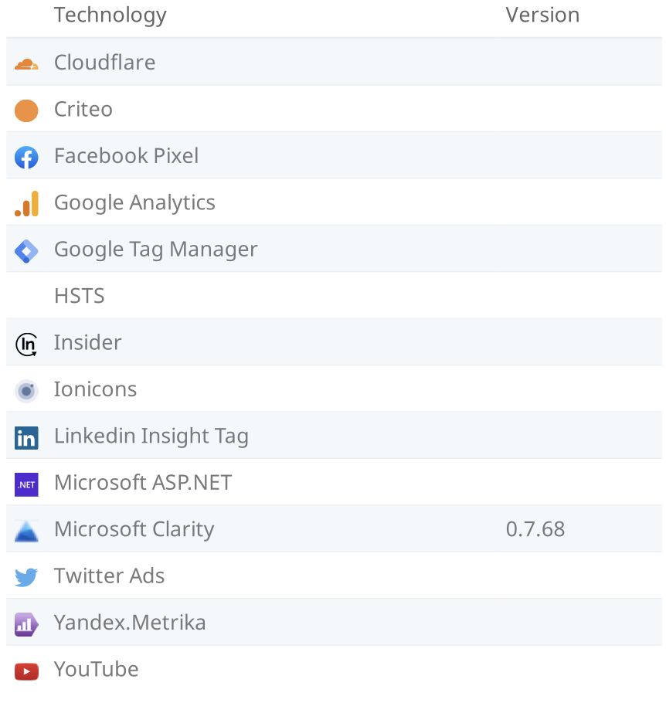
Technology Results
These software or coding libraries have been identied on the page

Slide 21
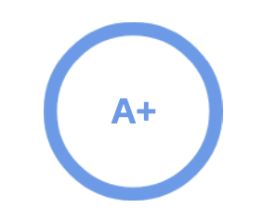
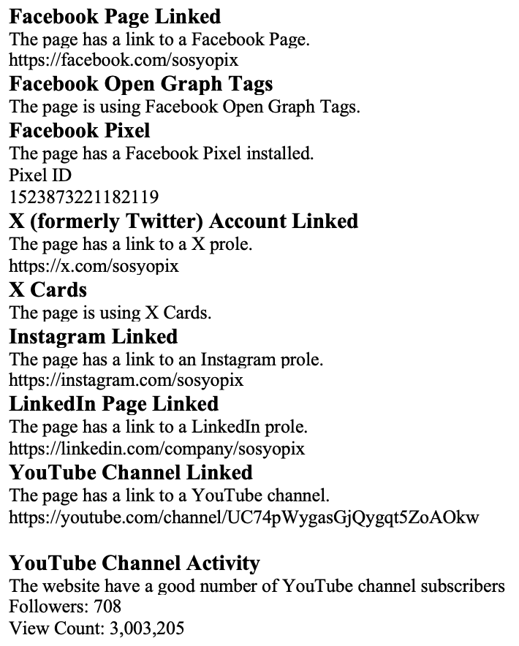
The social is very good!
The social presence is strong and active. Social activity is important for customer communication, brand awareness and as a marketing channel to bring more visitors to the website.
Social Media & Analytics
Strong Social Media Presence:
Facebook, Twitter, Instagram, LinkedIn, and YouTube linked
YouTube channel:
708 followers & 3M+ views
Google Analytics:
Not connected
Google Search Console:
Connected and active

Slide 22
Key Findings & Recommendations
The Technical SEO Audit of www.sosyopix.com reveals that the website is well-structured and optimized in many areas, but critical issues affecting performance, mobile usability, and indexing require attention.
Website structure is well-optimized for indexing.
On-page SEO factors like title & meta descriptions are generally optimized.
Backlinks profile is strong with many high-quality links.
Site security (SSL, HTTPS) is properly implemented.
Mobile responsiveness is present, but improvements are needed.
Issue | Impact | Recommended Fix
Core Web Vitals(LCP,CLS) failing | High | Optimize images, lazy loading
Slow Mobile Page Speed | High | Reduce JavaScript blocking
Missing Schema Markup | Medium | Implement LocalBusiness & Product Schema
Broken Links Find | Medium | Fix or redirect broken URLs
Keyword Usage is Low in Key Areas | Medium | Improve keyword presence in headings
Site Indexing & Crawlability: The site is properly indexed with no major blocking issues.
On-Page SEO & Content Optimization: Keyword usage should be improved in critical areas like H1 and ALT attributes.
Technical SEO Fixes: Schema Markup, URL structure, and JavaScript execution need better optimization.
Performance & Core Web Vitals: The mobile experience is suboptimal due to slow loading times and high LCP scores.
Backlinks & External Factors: The backlink profile is strong, but low-quality links should be disavowed.

Slide 23
Conclusion
To maximize SEO performance, the following steps should be taken:
Improve Core Web Vitals: Optimize LCP, FID, and CLS scores for a better user experience.
Enhance Page Speed: Implement JavaScript minification, lazy loading, and CDN caching.
Fix Broken Links: Use 301 redirects or remove non-functional links.
Implement Schema Markup: Use Product, LocalBusiness, and Breadcrumb structured data to improve search appearance.
Optimize Mobile Usability: Ensure text readability, tap targets, and mobile responsiveness are properly configured.
Monitor Backlink Profile: Remove spammy backlinks and acquire high-authority links.
By addressing these issues, www.sosyopix.com can enhance search engine rankings, user engagement, and overall site performance.

Slide 24
Thanks For Listening
You can find the Technical SEO Audit Report by clicking here

